Slide 1
Movie Recommendation Engine
Made by:
1. Afroz Chakure
2. Avadhesh Yadav
3. Himanshu Rathore
4. Sahil Jagotra
Stream Head & Coach Name:
Mr. Vishal Kumar

Slide 2
What is a Recommender System ?
A recommender system is a subclass of information filtering system that seeks to predict the rating or preference a user would give to an item. They are primarily used in commercial applications.
They are most commonly recognized as playlist generators for video and music services like Netflix, YouTube and Spotify, product recommenders for services such as Amazon, or content recommenders for social media platforms such as Facebook and Twitter.
Companies often use recommender systems for improving retention of customers on their product/ service, increasing sales, forming habits and to accelerate work.

Slide 3
Types of Recommender Systems
Popularity Based Recommender : It offers generalized recommendations to every user based on movie popularity and (sometimes) genre. The basic idea behind this recommender is that movies that are more popular and more critically acclaimed will have a higher probability of being liked by the average audience. This model does not give personalized recommendations based on the user.
Content Based Recommender : These filtering methods are based on the description of an item and a profile of the user’s preferred choices. Here keywords are used to describe the items and a user profile is built to state the type of item this user likes. In other words, the algorithms try to recommend products which are similar to the ones that a user has liked in the past.

Slide 4
Types of Recommender Systems(Cont.)
3. Collaborative filtering Engine : It is usually based on collecting and analyzing information on user’s behaviors, their activities or preferences and predicting what they will like based on the similarity with other users. A key advantage of the collaborative filtering approach is that it does not rely on machine analyzable content and thus it is capable of accurately recommending complex items such as movies without requiring an “understanding” of the item itself.

Slide 5
Objective/ Goals
To build a Simple recommender that would recommend movies to the user based on the popularity and genre of the movies.
To build two Content Based Recommenders based on:
Movie Overviews and Taglines
Movie Cast, Crew, Keywords and Genre

Slide 6
Libraries used
Numpy - Provides objects for multi-dimensional arrays.
Pandas - Provides in-memory 2d table object called Dataframe
TfidfVectorizer - Transforms text to feature vectors that can be used as input to estimator.
CountVectorizer - Used to tokenize a collection of text documents and build a vocabulary of known words. It is also used to encode new documents using that vocabulary.
Cosine similarity - Metric used to measure how similar the documents are irrespective of their size. It measure the cosine of the angle between two vector projected in a multi-dimensional space.
SnowballStemmer - Stemmers remove morphological affixes from words, leaving only the word stem. Eg: Dog and Dogs will be treated as same words.
Notes:
The text must be parsed to remove words, called tokenization. Then the words need to be encoded as integers or floating point values for use as input to a machine learning algorithm, called feature extraction (or vectorization).
Cosine similarity is a metric used to measure how similar the documents are irrespective of their size. Mathematically, it measures the cosine of the angle between two vectors projected in a multi-dimensional space.

Slide 7
Dataset Used
The Full Dataset: Consists of 26,000,000 ratings and 750,000 tag applications applied to 45,000 movies by 270,000 users. Includes tag genome data with 12 million relevance scores across 1,100 tags.
The Small Dataset: Comprises of 100,000 ratings and 1,300 tag applications applied to 9,000 movies by 700 users.

Slide 8
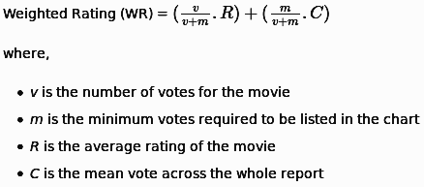
Criterion Used
IMDB’s weighted rating formula has been used to give calculate the weighted rating for the movies based on the number of votes and the average rating of the movie.

Slide 9
Demo

Slide 10
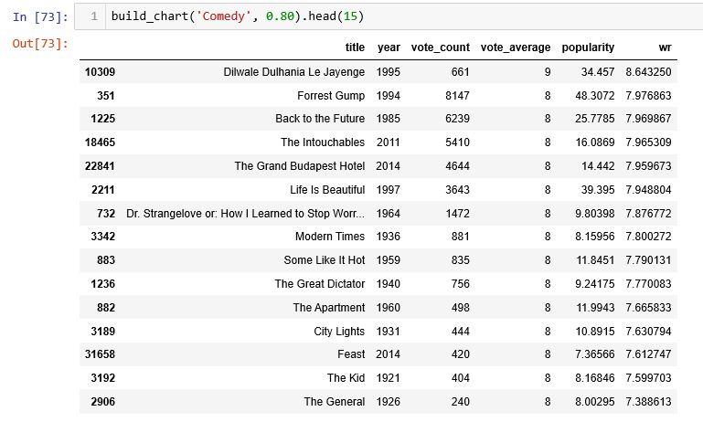
Results:
Simple Recommender System

Slide 11
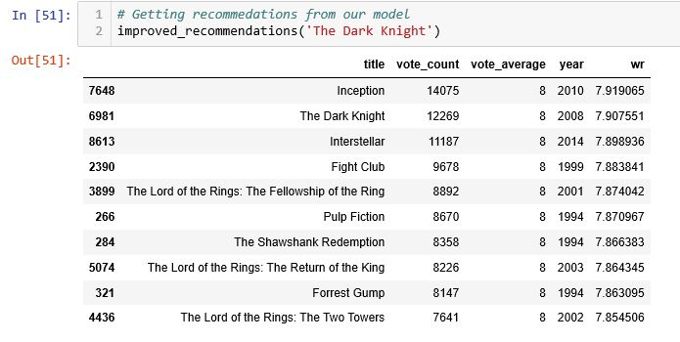
Content Based Filtering

Slide 12
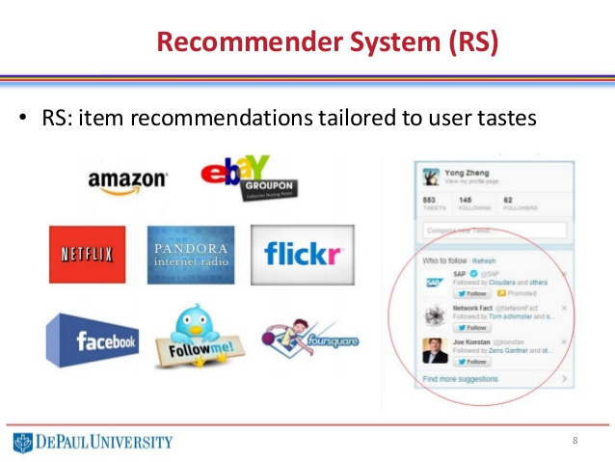
Applications:

Slide 13


